Slide 1












13 Optimizer Statistic Problems you Didn’t Know you Had
Fabiano Amorim
Data platform MVP since 2011
Principal Consultant
Pythian – Love your data

Slide 2
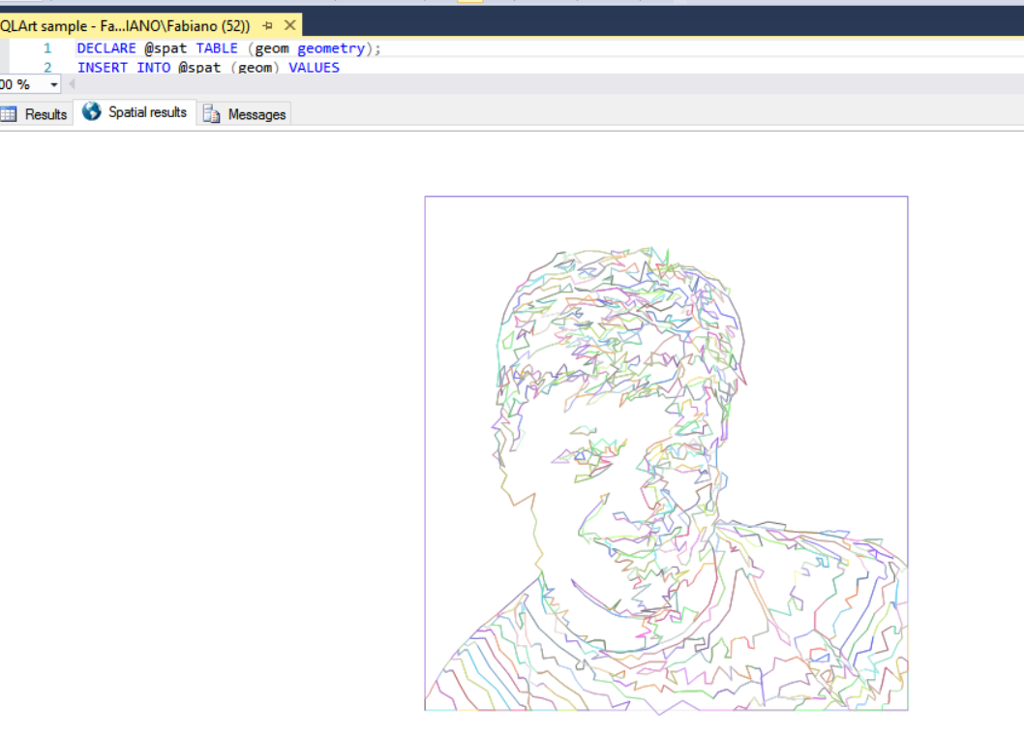




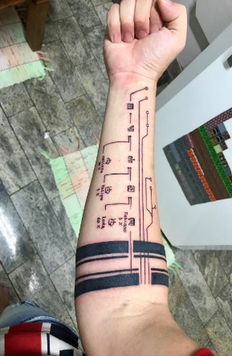

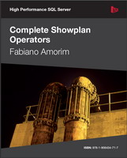





Fabiano Amorim
Principal consultant
Pythian
@mcflyamorim
linkedin.com/in/fabianoamorim/
fabianonevesamorim@hotmail.com
blogfabiano.com
github.com/mcflyamorim
red-gate.com/simple-talk/author/fabiano-amorim/

Slide 3
Agenda
“Statistics show every two minutes another statistic is created.” (Anonymous)
Query with OPTION(MAXDOP 1) and CXPACKET waits
Clustered columnstore
Reduce fullscan update stats duration
Stats on LOB columns
Inaccurate cardinality estimation – TF4199/QUERY_OPTIMIZER_HOTFIXES
Filtered stats
Index rebuild and sample update stats
Auto update stats async
TF2371 and DB compatibility level
Empty histograms
Duplicated stats
Long compilation and optimization time
Use TF2388 to get stats exec history
Bonus – Wrong metadata order
Bonus – Some comments about default sample ratio
Reminder – This is a 400 level session

Slide 4



Overview - Statistics
“There are three kinds of lies: lies, damned lies, and statistics.” (Leonard Courtney)
Query optimization is not easy
Statistics form the basis for a query optimization
Statistics help the query optimizer in choosing appropriate
execution plans to improve performance
You should consider to review SQL statistics in the following conditions:
1 - Query execution time is slow (luckily not a very common scenario, right ? ;P)

Slide 5

Demo

Slide 6
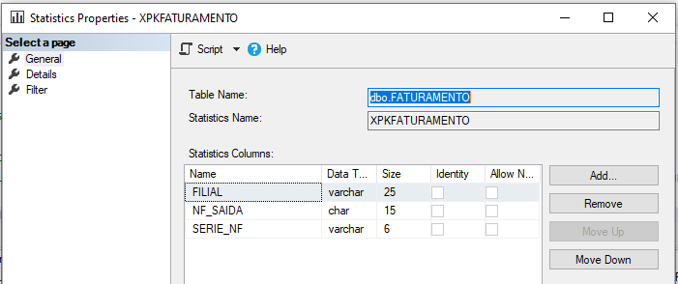
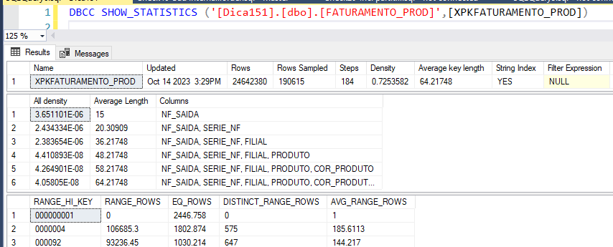
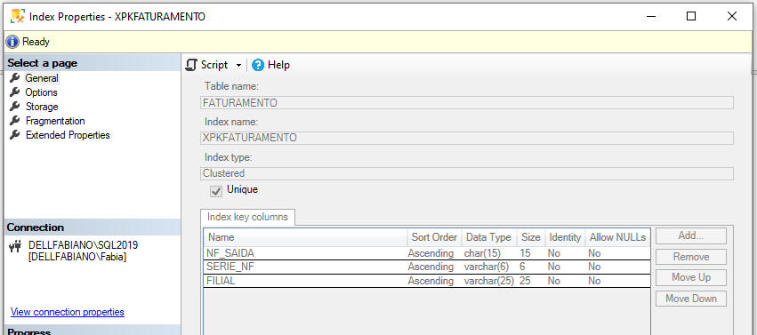
Bonus – Wrong metadata order
“First get the facts, then you can distort them as much as you want” (Mark Twain)
Notes:
BOL says that column "stats_column_id" of DMV sys.stats_column is "1-based ordinal within set of stats columns.". However, for index statistics this is not true as it actually reflects table definition order NOT the index order.
Luckily, this doesn't cause a query optimizer problem as the statistic is created based on the index key column, and not the statistic key column.
But, you may see a wrong order on SSMS user interface as it is reading the info from the sys.stats_column DMV.
Note: https://dba.stackexchange.com/questions/94533/is-sys-stats-columns-incorrect

Slide 7
Bonus – If time allows
“First get the facts, then you can distort them as much as you want” (Mark Twain)
Some comments about default sample ratio
The sampling algorithm is not entirely “random”. First, it samples pages and then uses all rows on the page. Second, it will sample the same pages each time. So, it is possible that the default sample rate will sample pages that do not contain all of the interesting rows that define the "spikes" in your data distribution. A higher sample rate can capture more of these rows, although it will be at a higher cost.
By default, big tables will get a very small sampling rate.
Since the sampling algorithm uses number of pages, a compressed index would increase the number of rows sampled, therefore, possible improving stat quality.
Tables that are smaller than 8MB (1024 pages) are always fully scanned to update/create statistics. SQL only consider in-row data, that is, all data types except LOB data types. In other words, if you have tons of LOB_DATA pages, SQL may still decide to do a scan on table to create/update the stat.
For the reverse engineered algorithm check https://github.com/mcflyamorim/statisticsreview/blob/main/IndividualChecks/Check42-SampleRate%20per%20table.sql

Slide 8
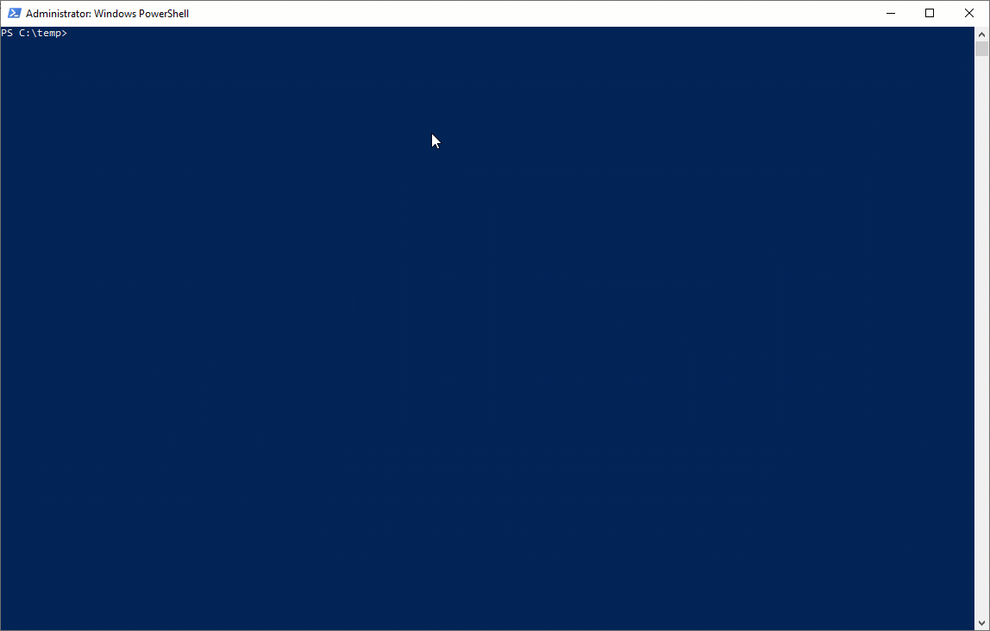
Reference: Statistics review script…
github.com/mcflyamorim/statisticsreview

Slide 9
Current list of checks
Check1-Stats history
Check2-Estimate upd stat freq
Check3-High compilation time
Check4-Stats and sort warning
Check5-Unused stats
Check6-Estimate mod per min
Check7-Upd stat threshold
Check8-Tiny tab OutOfDate
Check9-TF2371 dynamic threshold
Check10-Ascending stats
Check11-TF4139 hist amendment
Check12-TF2389 and TF2390 hist
Check13-TF4199 - QO hotfixes
Check14-Filtered stats
Check15-Data skew histograms
Check16-Filtered stat OutOfDate
Check17-NoExpand stats on views
Check18-DB setting
Check19-Inc. DB setting
Check20-Inc. partitioned stats
Check21-Async, background jobs
Check22-Modules running upd
Check23-Small percent sample
Check24-Adjust MAXDOP
Check25-NoRecompute
Check26-Stats on LOB columns
Check27-More stats than cols
Check28-Duplicated stats
Check29-Tables 10mi and sample
Check30-Out-of-date stats
Check31-Empty histograms
Check32-TF7471 parallel UpdStat
Check33-Persist_Sample_Percent
Check34-Stats full to sample
Check35-Hypothetical stats
Check36-Data from CommandLog
Check37-Sample on part. tab
Check38-Anti-matter columns
Check39-Missing column stats
Check40-Missing multi-col stats
Check41-AutoCreated multicol
Check42-SampleRate per table
Check43-Search maintenance plan
Check44-Auto_Stats xEvent
Check45-Stats load and linked
Check46-Bad internal stat order
Check47-Data skew histograms 2
Check48-Clustered columstore
Check49-Cloned DB columstore
Check50-Bad leading column
Check51-Maintenance time win
Check52-PlansWithLotStats
Check53-PlansHighModCount
Check54-Queries with distinct
Check55-Plan cache usage
Check56-Date info
Check57-Ascii graph histogram
Check58-Table growth

Slide 10
All question/answers you can get from the report
Number of out-of-date (more than 24 hours since last update) stats
Percent of stats considered out-of-date (more than 24 hours since last update)
Number of tiny table (less than or equal to 500 rows) with out-of-date stats
Number of stats with a sampling rate lower than 5% of table
Number of tables that will have an auto update/create sampling rate lower than 5% of table
Number of estimated events of stats being updated from fullscan to sample(due to an auto-update)
Number of statistics with modifications greater than 1000 or 1% of table
Number of stats with only 1 update since creation
Number of duplicated stats
Number of unused stats
Number of missing multi-column stats
Number of multi-column stats auto created on SQL 2000
Number of missing column stats events from default trace
Number of hypothetical stats
Number of stats with empty histograms
Number of tables with more stats than columns
Number of stats on LOBs (Large Objects) or BLOBs (Binary Large Objects)
Number of stats using static auto-update threshold
Number of stats on partitioned tables not using incremental stats
Number of partitioned tables that will have a sample rate in a index rebuild
Number of ascending/descending stats
Number of filtered stats
Number of good candidates for a filtered stats
Number of filtered stats considered out-of-date
Number of stats with "skewed" histograms causing bad cardinality estimation
Number of stats with a histogram step with a RANGE_ROWS greater than 50% of rows in the histogram
Number of stats with a histogram step with a EQ_ROWS greater than 50% of rows in the histogram
Number of stats with a histogram step indicating that a NULLs represents more than 10% of all rows in the histogram
Number of stats with an unecessary(with no modifications) update
Number of stats with an event of update with interval of less than 15 minutes
Number of stats with an event of update with interval greater than 25 hours
Number of stats with an estimated auto-update frequency of less than 1 hour
Number of stats with modifications greater than the average of all objs
Number of stats with an auto-update about to be triggered
Number of stats with modifications greater than auto-update threshold
Number of long query plan compilation/optimization time due to an auto update/create stats
Number of statistics with wrong metadata order
Number of tables with clustered ColumnStore indexes that may report wrong number of modifications
Number of sort spilled to tempdb due to an auto update/create stats
Number of DBs with auto-update-stats disabled
Number of DBs with auto-create-stats disabled
Number of DBs using auto-create-stats-async, but with auto-update stats disabled
Number of DBs with partitioned tables, but not set to use incremental stats
Number of multi-column stats with a bad leading column
Number of indexed views referenced in a module without noexpand query hint
Number of auto-update stats async pending on background job queue
Number of modules manually running "update statistics"
Number of plans with more than 50 loaded stats
Number of plans with loaded statistics with high modification count greater than 1k
Found a maintenance plan job?
Is there an extended event tracking Auto_Stats event?
Trace flag 2371 usage should be considered
Trace flag 4139 usage should be considered
Trace flags 2389 and 2390 usage should be considered
Trace flag 4199 usage should be considered
Trace flag 7471 usage should be considered
Number of stats using "persist sample percent"
Number of stats set to NoRecompute

Slide 11


Slide 12

Q&A Don’t forget to fill out the evaluation.
SELECT "About me:"
FROM (VALUES('Fabiano Neves Amorim'),
('Data Platform MVP'),
('fabianonevesamorim@hotmail.com | @mcflyamorim'),
('Principal Consultant – Pythian(Love your data)'),
('http://blogfabiano.com')) AS Tab("About me:")
?

